Slide 1
ALABAMA’S UNIFORM COMMERCIAL CODE AMENDMENTS 2022
Hairston-1
Alabama Act #2023-492
effective July 1, 2024

Slide 2
The need for the Amendments
Hairston-2
Has current technologies advanced beyond the existing UCC?
How should the UCC embrace the movement to an electronic and digital world?
How to use Digital Assets (which are general intangibles under current law) in today’s commercial practice?
How to deal with Electronic Money/Virtual Currency (Not in Alabama)?
Are the present concepts of “Control” workable in tomorrow’s practice?
Is Chattel Paper the paper or the obligation?
Can there be electronic instruments (i.e. not a ”writing”)?
Can there be electronic documents of title (i.e. not a “writing”)?
Are “transferable records” under E-Sign and the UETA our only purely electronic alternatives?
What are the legal guardrails to allow emerging systems to operate?
Notes:
Does not deal with:
Whether a digital asset is a security or a commodity for regulatory purposes
Taxation of digital assets
Money transmission laws
Anti-money laundering laws

Slide 3
Article 12 – Controllable Electronic Records (CER)
Hairston-3
Controllable Digital Assets (Bitcoins, crypto, some NFTs)
General Intangible under Article 9A (Ala Code §7-9A-102(a)(42)
CER are defined in Ala Code §7-12-102(a)(1) as a “record” (Ala Code §7-1-201(b)(31) that is “electronic” (Ala Code §7-1-201(b)(16A) and that is susceptible to “control”* (Ala Code §7-12-105)
Exclusions
Controllable Account and Controllable Payment Intangible
Chattel paper in electronic form (handled in Article 9A)
Electronic documents of title (handled in Article 7)
Investment property (handled in Article 8) (however a CER can opt in to being a financial asset under Article 8 and be subject to Article 8 control rules)
Transferable records (handled in UETA and E-SIGN)
Deposit accounts (handled in Article 9A))
Electronic (fiat) money
*A digital asset that cannot be subject to control

Slide 4
Article 12 – Control §7-12-105
Hairston-4
Power to enjoy “substantially all the benefit” of the CER (does not have to be “exclusive”)
The exclusive power (which may be shared or obtained through another person) to prevent others from enjoying “substantially all the benefit” of the CER
Exclusive power to transfer control to another person
The person must be able to identify itself to a third party as the person having these powers (can be done by cryptographic key or account number)
These requirement are generic formulation of what industry is presently embracing
[Articles 7, 8, and 9A amended to embrace this control test for electronic records governed by those articles]
As to controllable accounts and controllable payment intangibles, must have control over CER evidencing the controllable account or controllable payment intangible
Notes:
Rebuttable presumption of exclusivity
Control for another
A has control but acknowledges that A has control for B. B also has control.
Exclusivity requirement is satisfied even if certain sharing/multi-sig arrangements have been agreed to by the parties or are built into the system in which the CER is recorded
multi-sig arrangements

Slide 5
Article 12 – Transfer §7-12-104 (Qualifying Purchaser)
Hairston-5
Take Free Rule (takes free of any Article 12 claim to the CER) if a Qualifying Purchaser
A “qualifying purchaser” is a purchaser who obtains control of a CER for value (Article 3 Value), in good faith, and without notice of a property claim to the CER
Shelter Principle (if not Qualified purchaser)
Only dealing with Article 12 CER rights, not property rights that support or are evidenced by the CER (ie copyrights, licenses, rights not covered under Article 12 etc.)
The filing of a financing statement of itself is not notice of a claim to the CER
Take Free Rule also apply to Controllable Accounts and Controllable Payment Intangible if Qualifying Purchaser of CER

Slide 6
Article 12 – Controllable Account; Controllable Payment Intangible; Account Debtors §7-12-106
Hairston-6
An “account” or “payment intangible” evidenced by a CER is a “controllable account” or “controllable payment intangible” if the account debtor has agreed to pay the person in control
A controllable account or a controllable payment intangible travels with the CER, and the transferee benefits from the same “take-free” rule as is available with the CER
The effect is to create an electronic instrument
If the terms of the CER provide that the account debtor will not assert claims or defenses against the transferee of the CER (see Ala Code §7-9A-403), then the effect is to create an electronic negotiable instrument
Account debtor discharge rule (similar to Ala Code §§ 7-3-602 and 7-9A-406)

Slide 7
Article 12 – Choice of Law §7-12-107
Hairston-7
Look to the law where the CER is located
The CER is located in the jurisdiction by which the CER is expressly stated to be governed
If the CER is not expressly stated to be governed by the law of a jurisdiction, the CER is located in the jurisdiction which is stated to govern the system in which the CER is recorded
Otherwise, the CER is located in the District of Columbia or, if DC has not adopted the UCC amendments, the Official Text applies.
But for the account debtor discharge rule, look to
The law governing the agreement under which the controllable account or controllable payment intangible arose if that agreement is effective under applicable law
Otherwise, look to the law of the location of the CER

Slide 8
Article 12A – Transition
Hairston-8
ALABAMA
EFFECTIVE DATE: July 1, 2024
ADJUSTMENT DATE: July 1, 2025
Revisions effective in Alabama July 1, 2024
Prior to July 1, 2025 (the Adjustment Date) the parties’ perfection priorities established on Effective Date control
Following July 1, 2025 (the Adjustment Date) the parties’ perfection priority are governed by the Ala Code §7-9A-326A.
Designed to protect the expectations to parties to pre-amendments effective date transactions and to provide for sufficient time for parties to plan transactions post-amendments effective date
The adjustment date gives transacting parties a grace period to preserve priorities already established on the effective date if the amendments would otherwise affect those priorities.
Notes:
Examples:
Pre-enactment date, SP1 perfects interest in CERs by filing. Also pre-enactment date, SP2 takes control of the same CERs but does not file. SP1 has priority over SP2
Post-enactment date but pre-adjustment date, SP1 retains its priority temporarily, allowing time to revise loan terms and agreements. If SP1 takes no action, on the adjustment date SP2 with control will have priority over SP1 who only perfected by filing

Slide 9
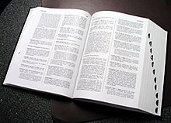
Article 9A – Defined Terms
Hairston-9
Collateral categorization: no need to change collateral descriptions in security agreements or collateral indications on financing statements
A CER is a “general intangible” Ala Code §7-9A-102(a)(42)
A controllable account is an “account” Ala Code §7-9A-102(a)(2) and (27A)
A controllable payment intangible is a “payment intangible” Ala Code §7-9A-102(a)(61) and (27B)
Assignee/Assignor definitions added - Ala Code §7-9A-102(a)(7A) and (7B)
Deletion of term “Authenticate” Ala Code §7-9-102(a)(7)

Slide 10
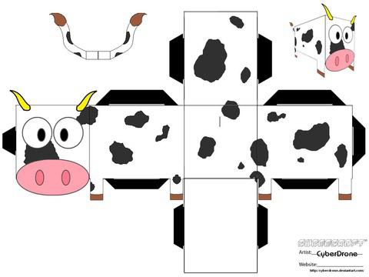
Article 9A – Chattel Paper
Hairston-10
Chattel Paper redefined to represent obligation as opposed to paper - Ala Code §7-9A-102(a)(11)
Perfection by Possession and Control of Chattel Paper. - Ala Code §7-9A-314A
Chattel Paper choice of law – Ala Code §7-9A-306A

Slide 11
Article 9A – Notifications and Miscellaneous
Hairston-11
Attachment: no change - normal rules apply
Perfection - By filing, or by control (updated control rules) with non-temporal priority for a secured party who perfects by control Ala Code §7-9A-326A
Updated control test - Ala Code §§7-9A-104, 7-9A-105, 7-9A-107A, and 7-9A-107B
After-Acquired Property; Future Advances. Ala Code §7-9A-204.
Clarified Notification of Disposition of Collateral Ala Code §§7-9A-613 (non consumer) and 7-9A-614 (consumer)

Slide 12
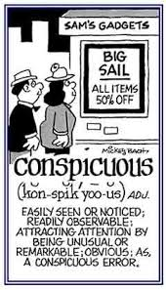
Article 1 - Definitions
Hairston-12
“bearer” (Ala Code §7-1-201(b)(5)) is expanded to include one having control
“electronic” (Ala Code §7-1-201(b)(16A)
“deliver” (Ala Code §7-1-201(b)(15)) is expanded to include transfer of control
“holder” (Ala Code §7-1-201(b)(21)) is expanded to include one having control
the term “record” (Ala Code §7-1-201(b)(31)) is substituted for “writing” throughout the UCC to encompass electronic documents
“send” (revised Ala Code §7-1-201(b)(36)) redefined to permit electronic transmission
“sign” (revised Ala Code §7-1-201(b)(37)15) is redefined to include electronic signatures
the term “conspicuous” (Ala Code §7-1-201(b)(10) is redefined to apply more broadly based on a “totality of circumstances/reasonable person” test administered by the Court to the terms of both paper and electronic documents.

Slide 13
Article 2 & 2A – Hybrid Transactions
Hairston-13
A hybrid transaction is a transaction where services or licenses of information are supplied in connection with the sale or lease of goods.
Ala Code §§7-2-102(2), and 7-2-106(5) for the sale of goods and Ala Code §§7-2A-102(2) and 7-2A-103(1)(h.1) now statutorily recognize, using Alabama’s prevailing purpose test hybrid transactions in connection with the sale or leasing of goods.
Finance Lease exception

Slide 14
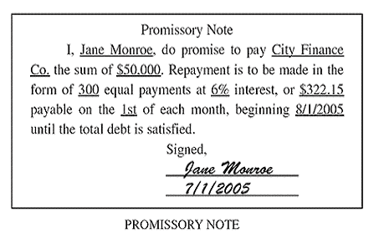
Article 3 & 4 - Instruments
Hairston-14
The UCC revisions allow certain ministerial terms within an instrument to not affect the instruments’ negotiability, non “wet” signatures, and permit images of certain instruments to be substituted for the instrument in accordance with federal banking regulations.
Ala Code §7-3-104(a)(3) – choice of law and choice of forum clause does not affect negotiability
Ala Code §7-3-105(a)(2) – image may be substituted for actual instrument in accordance with banking regulations
Ala Code §7-3-401 - a “wet” signature is no longer required on an instrument
Ala Code §7-3-604(a) – obligation to pay not discharged solely by destruction of check when image is thereafter transmitted

Slide 15
Article 4A – Security Procedures
Hairston-15
Ala Code § 7-4A-201 has been amended to permit a security procedure to impose an obligation on the receiving bank or the customer, and to clearly delineate that simply requiring a payment order to be sent from a known email address, IP address or telephone number is not by itself a security procedure

Slide 16
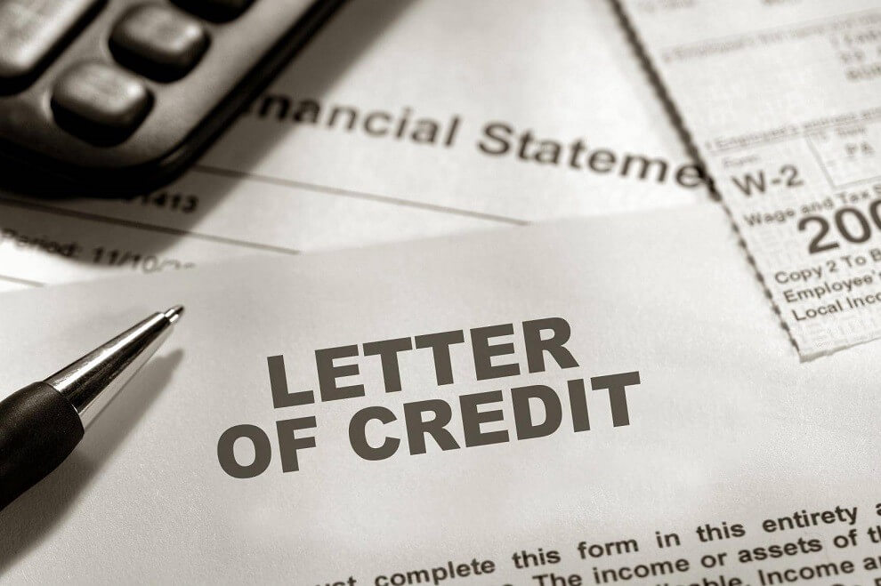
Article 5 – Letters of Credit
Hairston-16
Ala Code §7-5-104 – signed electronic records have same legal effect as signed tangible documents. Electronic Signatures are now permitted on letters of credit.
Ala Code §7-5-116(d) underscores branch separateness

Slide 17
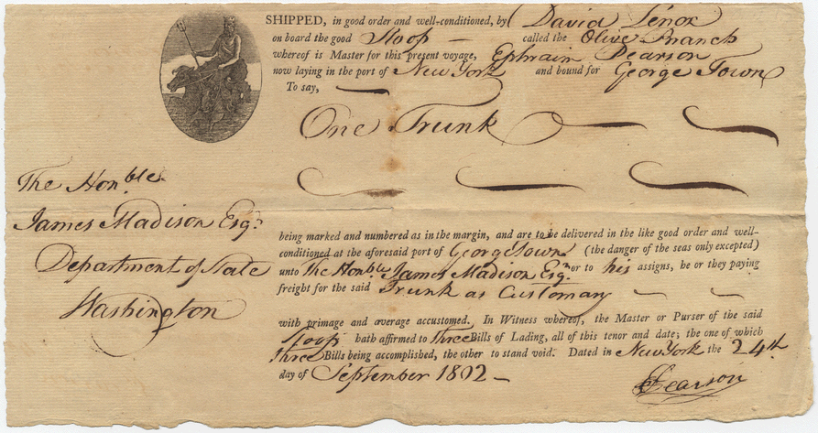
Article 7 – Control of Documents of Title
Hairston-17
Ala Code §7-7-106 incorporates the updated control test for documents of title

Slide 18
Article 8 – Control of Security Entitlements
Hairston-18
Ala Code §7-8-106 incorporates the updated control test for Security Entitlements
Aside: If Ala Code §7-8-102(a)(9)(iii) applies, Controllable Electronic Record, Controllable Account and Controllable Payment Intangible can be a Financial Asset

Slide 19
Structuring deals starting now
Hairston-19
Controllable electronic record
Confirm that the elements of control will be satisfied
Include a choice-of-law and choice-of-forum provision, if practicable, pointing to a state that has adopted the amendments
Controllable account or controllable payment intangible
Note that the controllable account or controllable payment intangible must be “evidenced” by a CER
Confirm that there is or will be an agreement by the account debtor to pay the person in control
Confirm that there is or will be a method for the person in control to provide a commercially reasonable deflection notification to the account debtor to pay the person in control, with the method being agreed to by a record “signed” by the account debtor
Transferable record (UETA or E-Sign)
Include a choice-of-law and choice-of-forum provision, if practicable, pointing to a state that has adopted the amendments
Chattel paper evidenced by an electronic record, and electronic documents of title
Confirm that the elements of control will be satisfied
May need to use a consultant to confirm that the elements of control have been satisfied
Alternatively consider the use of UCC Article 8 for collateral held through a custodian or exchange
Drafting a control agreement
Drafting an intercreditor agreement if control is shared with another creditor (see Ala Code §7-9A-326A)

Slide 20
Updating Current Forms
Hairston-20
Substitute “signed” for “authenticated”
Make sure to require that debtor include in controllable accounts and controllable payment intangibles agreement of account debtor to pay person in control of controllable electronic record that evidences the controllable accounts or controllable payment intangibles
Grant of security interest
Include specific references to controllable electronic records, controllable accounts, and controllable payment intangibles if sub-categories of collateral are mentioned
Note that controllable accounts are “accounts”
Note that security interest in “controllable electronic record” does not create security interest in controllable accounts or controllable payment intangibles evidenced by the controllable electronic record
Include covenants requiring steps to obtain control of a controllable electronic record, a controllable account, or a controllable payment intangible
Prohibit anyone else obtaining control
Add representation, warranty and covenant for a commercially reasonable method for the person in control to provide a deflection notice to an account debtor on a controllable account or controllable payment intangible and require agreement of the account debtor in a signed record to such method
Add agreement as to method of disposition of collateral consisting of controllable electronic records
Update perfection certificate to include controllable electronic records, controllable accounts, and controllable payment intangibles
Make sure choice of law is addressed in the controllable electronic record or chattel paper

Slide 21
Conducting Due Diligence
Hairston-21
Determine the existence of and the debtor’s rights in any controllable electronic records, controllable accounts, controllable payment intangibles, or electronic money
Was debtor a qualifying purchaser when it acquired the CERs, controllable payment intangibles, and controllable accounts?
Will secured party be a QP?
Review controllable electronic records, controllable account, and controllable payments intangibles for:
Choice-of-law provisions pointing to states that have adopted the amendments
For controllable accounts and controllable payment intangibles, and agreement of account debtor to pay person in control of CER that evidences the controllable account or controllable payment intangible
Determine whether someone else has control
Determine whether the account debtor on any controllable account or controllable payment intangible has agreed in a signed record to a commercial reasonable method for the person in control to provide a deflection notification
Confirm that the elements of control have been satisfied for controllable electronic records, controllable accounts, controllable payment intangibles, chattel paper evidenced by an electronic record, and electronic documents of title

Slide 22
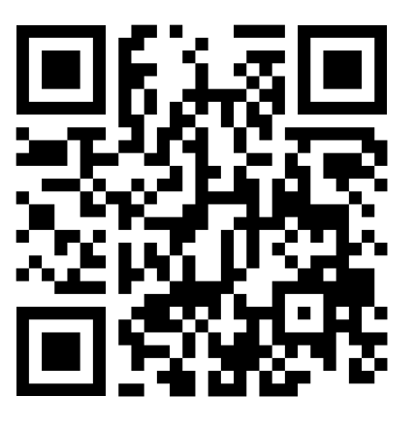
Questions and Answers
Hairston-22
Bill Hairston
Hairston@me.com
205-919-1008

