Slide 1
CORPORATE TRANSPARENCY ACT
Hairston-1
CTA
Notes:
QR CODE is for webpage containing Slides in PDF and PowerPoint format along with links to important information

Slide 2
Corporate Transparency Act held Unconstitutional by U.S. District Court in Northern District of Alabama
Hairston-2
On March 1, 2024, the U.S. District Court for the Northern District of Alabama in National Small Business United et al. v. Janet Yellen et. al., Case No. 5:22-cv-1448-LCB, held the Corporate Transparency Act (the “CTA”) to be unconstitutional. U.S. District Court Judge Liles C. Burke's Memorandum Opinion stated on page 52 “The CTA is unconstitutional because it cannot be justified as exercise of Congress’ enumerated powers.” The Court’s holding asserts Congress lacks the authority to require companies to disclose personal beneficial owner information to the U.S. Treasury Department's criminal enforcement arm, the Financial Crimes Enforcement Network (FinCEN). The Court in so ruling, then permanently enjoined FinCEN from enforcing the CTA against the plaintiffs. Notably, the ruling applies narrowly to the plaintiffs in this case, leaving uncertainty regarding its implications for companies not a party to the litigation. It is anticipated Treasury will file an appeal to the U.S. Court of Appeals for the Eleventh Circuit.

Slide 3
WHY ARE WE HERE? WHAT IS THE CORPORATE TRANSPARENCY ACT and WHY DO I NEED TO KNOW ABOUT IT?
Hairston-3
The Corporate Transparency Act (“CTA”) was adopted as Title LXIV (64) of the 2021 National Defense Authorization Act (31 U.S.C. §5336) and mandates the creation of a national database for the “beneficial ownership” information of many businesses
ASSIDE: the NDAA passed in the House and Senate with veto-proof margins and President Trump’s December 23, 2020 veto was overridden on January 1, 2021
The Reporting Rule 87 FR 59498 (9/30/22) was promulgated on September 30, 2022 and is codified in 31 CFR §1010.380
The CTA requires business entities (except those expressly exempted) to report certain information about their company, their Beneficial Owners, and the individuals who created or registered them to do business (including their lawyers in some cases), their applicants to FinCEN.
A tool to prevent Money Laundering
Notes:
Supposedly to prevent Money Laundering US Department of Treasury creating a DataBase of all Beneficial Owners
Access to this database will be by request from:
- Banks
- CU
- law enforcement (state and federal)
- IRS etc
Real reason In my humble opinion is to add another crime into FinCEN’s arsenal to stop crime (more about this when we get to penalties
FinCEN (the enforcement arm of Treasury is responsible for creation of and management of this DataBase

Slide 4
Who is FinCEN?
Hairston-4
Notes:
FinCEN – Treasury’s Enforcement Arm to prevent Financial Crimes

Slide 5
Is My Company a “Reporting Company”?
Hairston-5
All Non-Exempt Reporting Companies Must File a Beneficial Ownership Report
Notes:
Reporting Companies (unless EXCEPTION)
Corporations
LLCs
Any other entity that is created by the filing of a document with a secretary of state or any similar office under the law of a State or Indian tribe
Any foreign entity registered to do business in any State or tribal jurisdiction by a similar filing
No matter how long ago they were formed

Slide 6
What Companies May Not Meet that Definition?
Hairston-6
LLPs (not “created” by filing)
Massachusetts (but not Delaware) business trusts
Entities resulting from a statutory conversion process, because most conversion statutes say the resulting entity is the same entity as pre-conversion, so not “created” by the filing
Any foreign entity that simply doesn’t bother to register to do business
Notes:
Companies not CREATED by filing.
Cautiously use this loophole

Slide 7
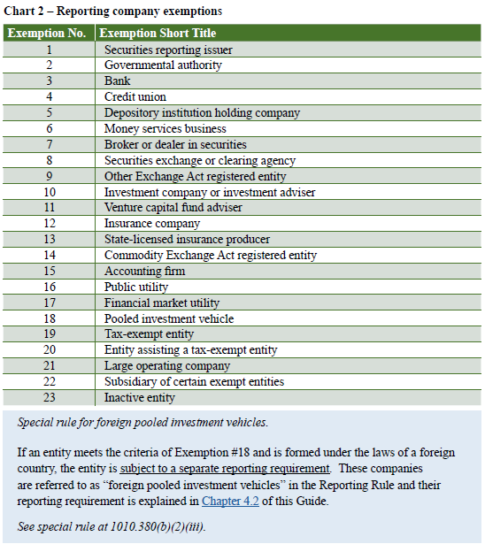
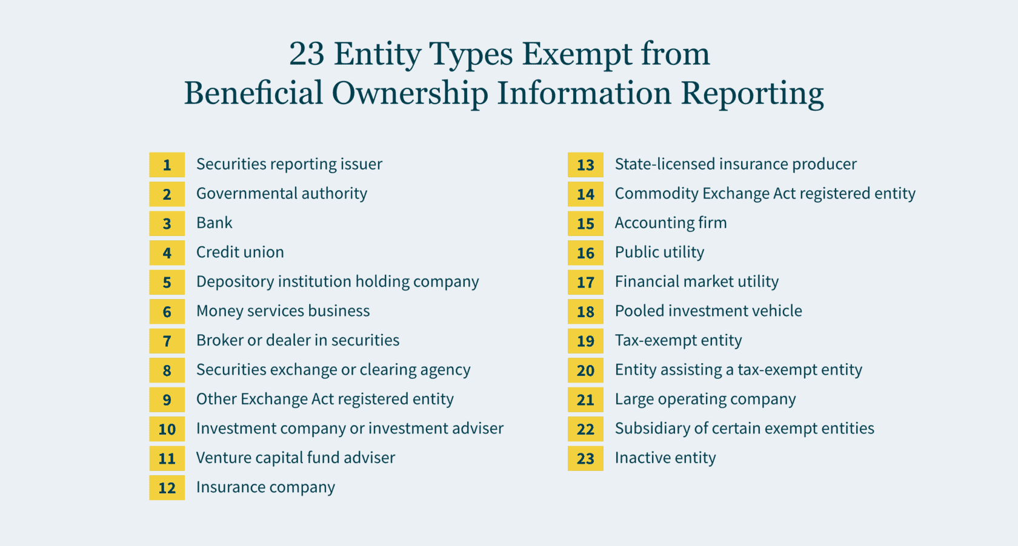
Reporting Company Exemptions
Hairston-7
Notes:
Securities Reporting Issuer under SEC Act
Governmental Authority providing governmental services
Bank
Credit Union
Depository Institution
Money Transmitters
Broker or Dealer of Securities
Securities Exchange or Clearing Agency
Investment Company or Investment Advisor
Capital Fund Advisor
Insurance Company
State licensed insurance provider
Commodity Exchange Agent
Public Accounting Firm (SOX creation)
Public Utility
Pooled Investment vehicle
Tax Exempt Entity under 501(c) or 527(e)(1) (political organization) (not just non-profit entity)
Entity (exclusively assisting tax exempt entity
Large operating company
Subsidiaries of Exempt entities
Inactive entities

Slide 8
Large Operating Company Exception
Hairston-8
SATISFACTION OF ALL OF THE FOLLOWING:
More than 20 employees
More than 20 employees in United States
Physical presence in United States
$5,000,000 or more gross receipts in prior year
Reporting of all gross receipts to IRS
If gross receipts include foreign receipts, then gross receipts less foreign receipts must be in excess of $5,000,000
WATCH OUT: If Large Operating Company ceases to meet these requirements, it is no longer exempt.
Notes:
Full Time Employees
Averaging method
Watch out if fall below 20 then must file (within 30 days).

Slide 9
Inactive Entity Exception
Hairston-9
If in existence before January 1, 2020
No change of ownership in last 12 months
No receipts of over $1,000 in past year
Owns no assets
Notes:
Birmingham Camellia Club Inc

Slide 10
When to Report
Hairston-10
If entity formed prior to January 1, 2024, then by January 1, 2025
If formed after January 1, 2024 and prior to January 1, 2025, then within 90 days of filing
If formed after January 1, 2025, then within 30 days of filing
If change occurs, report must be updated within 30 days of change
If become aware of inaccuracies, then must correct within 30 days
What happens when Driver License, ID, or Passport expires? - Must amend within 30 days, unless FinCEN ID used, then holder of FinCEN ID must amend within 30 days!
Notes:
Any Change
- DL renewal
- passport renewal
- address change
- new senior officer hire
- new board member
- death
- marriage and name change
- gender identity change reflected on DL
- what happens if DL revoked due to DUIs

Slide 11
What must be reported?
Hairston-11
Reporting Company’s Information
Entity’s legal Name,
Entity’s DBA (if any) (name used on Tax return?)
Entity’s State of Formation,
Entity’s US street address, and
Entity’s TIN or EIN
For each Company Applicant (if entity formed after 1/1/24)
Either the individual’s FinCEN ID Number or
full legal name,
business address,
date of birth,
Driver’s licenses, Government issued ID, or Passport number, and
Image of Driver’s License, ID, or Passport used
For each Beneficial Owner
Either the owner’s FinCEN ID Number or
full legal name,
residential address,
date of birth,
Driver’s licenses, Government issued ID, or Passport number, and
image of Driver’s License, ID, or Passport used
Notes:
Remember name on IRS tax return is a DBA name if not legal entity name

Slide 12
Is my Company required to report its company applicants?
Hairston-12
Practice Tip: When a company formed prior to January 1, 2024 E-files their BOIR, they must affirmatively check the box that Company applicant does not need to be disclosed for the company
Notes:
Check the box if exempt

Slide 13
Who’s a “Company Applicant”?
Hairston-13
Any [i.e., can be up to two] individual who files the document that creates the domestic reporting company, including any individual who “directs or controls” that filing by another person
For purposes of two applicant limit, the person who files plus the person most responsible for causing the filing
For a foreign reporting company, any individual who files the document that first registers the foreign reporting company, including any individual who “directs or controls” that filing
Companies existing as of January 1, 2024 need not file applicant info, and reporting companies need not update applicant info after filing (provided you affirmatively check the non-applicability box on your initial filing).

Slide 14
Who is Beneficial Owner?
Hairston-14
A Beneficial Owner is an individual who directly or indirectly:
exercises Substantial Control, or
owns or controls 25% of ownership or voting interest of the entity
Subject of course to a few limited exceptions
Notes:
Direct or Indirect Control
Board representation
Ownership or control of voting shares
Rights associated with any financing arrangement or interest in a company
Through any other contract, arrangement, understanding, relationship
Or otherwise! (Trust powers?)

Slide 15
What is “Substantial Control”?
Hairston-15
Notes:
First Line = Corporation, second line = LLC, and Third Line is CATCH ALL
Senior Officer:
One holding the position of or exercising the authority of a
President
CFO
General Counsel
CEO
COO
“or any other officer regardless of official title who performs a similar function as these officers”
Senior Officer concept although not using LLC terminology applies to LLC
Important Decision Maker
Mere employee exception to come
Trust Protector/Advisor???

Slide 16
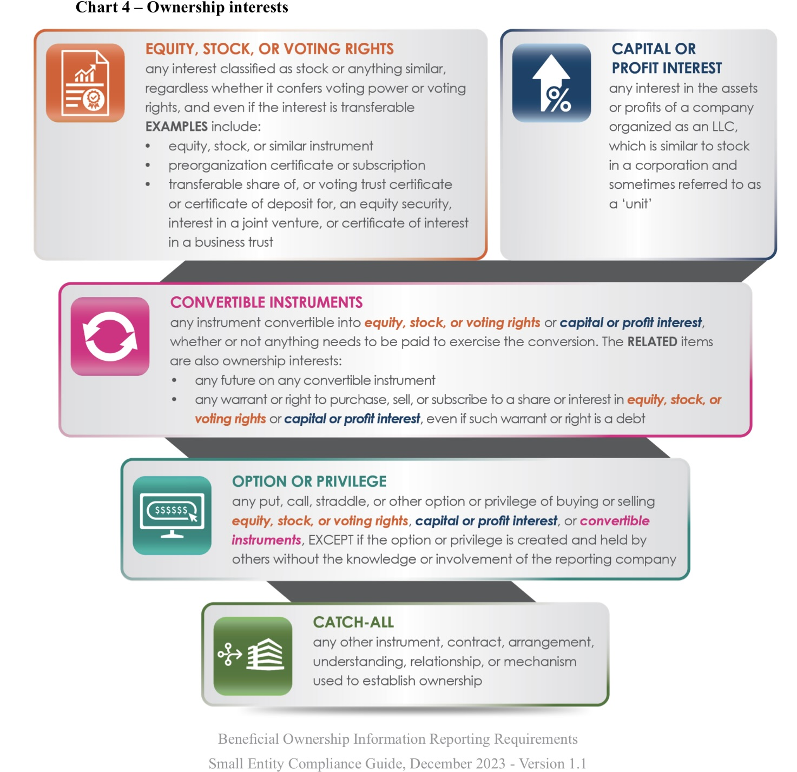
What is “Ownership Interest”?
Hairston-16
Notes:
First block = Corporation,
second block = LLC
Third block – possible future interest
Fourth Block is CATCH ALL
Trusts, Convertible Debt, Purchase Options, Puts, Calls
Assume immediate exercise of all options and other equity conversion rights, and then determine who has 25% or more of combined “equity voting power”
--but no provision made for situations where voting rights are limited to certain events
• If capital and profits interests involved, 25% of all capital and profits interests
• Or if greater, 25% of all value of equity, assuming all exercises/conversions
• Or if neither of the above is calculable, 25% of any class of equity

Slide 17
Reporting Company with Multiple Indirect Owners
Hairston-17
Notes:
Individual A, B, C, and F are beneficial owners

Slide 18
Beneficial Ownership Exceptions
Hairston-18
Minors (provided parent or guardian reported)
Employee who is not a Senior Officer (or similar person) and who does not own or control at least 25%
Individual who merely advises or acts on behalf of a Beneficial Owner (i.e. power of attorney or conservator)
Person whose only interest is as recipient of future inheritance
Creditor (unless creditor hold control feature)
If individual ownership is indirect through a large operating company, then the individual need not be disclosed provided the large operating company is disclosed.
Notes:
Creditors with excess of 25% stock pledge
Creditors with proxy
Remember CERCLA cases “own or control” - Fleet Factors

Slide 19
Beneficial Ownership Informational Report
Hairston-19
The Beneficial Ownership Informational Report can ONLY be filed electronically via BOI E-Filing System
Two ways to file electronically:
Download PDF form to fill offline and then follow instructions on PDF form to upload form.
Complete and submit online
Frequently Asked Questions

Slide 20
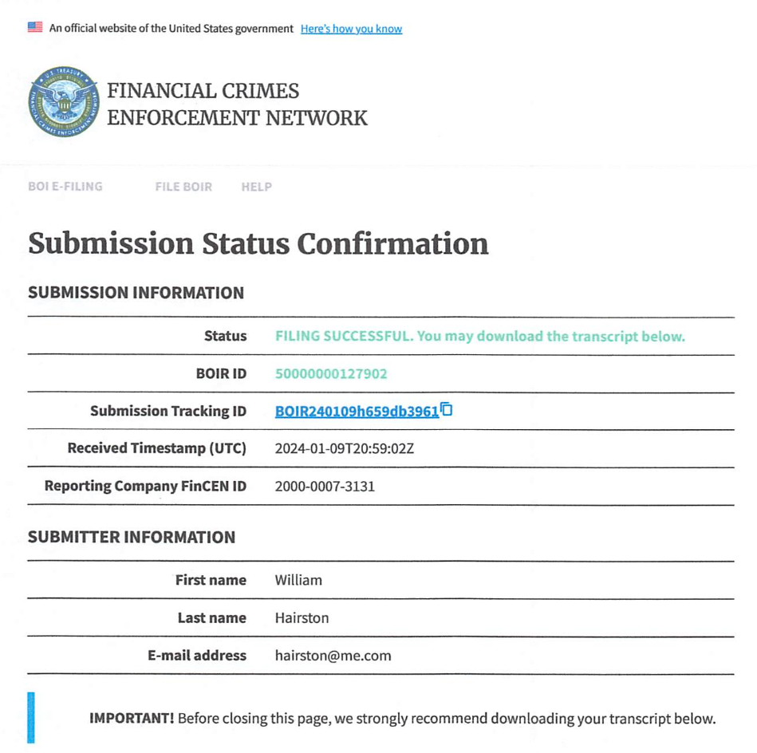
Beneficial Ownership Informational Report Results
Hairston-20
Notes:
Name of Company never appears on receipt.

Slide 21
FinCEN ID
Hairston-21
Info needed:
Full legal name
Address
Date of Birth
Type of identification (Government ID, DL, Passport)
Upload of electronic copy of the identification
Welcome to the FinCEN ID Application for Individuals
Notes:
So that companies do not need to keep up with individual’s changes (DL, Passport, gender identity, etc) use FinCEN ID for person
Regs do not discuss whether you can require individual to obtain (and keep current) FinCEN ID but that might be something to include in documents

Slide 22
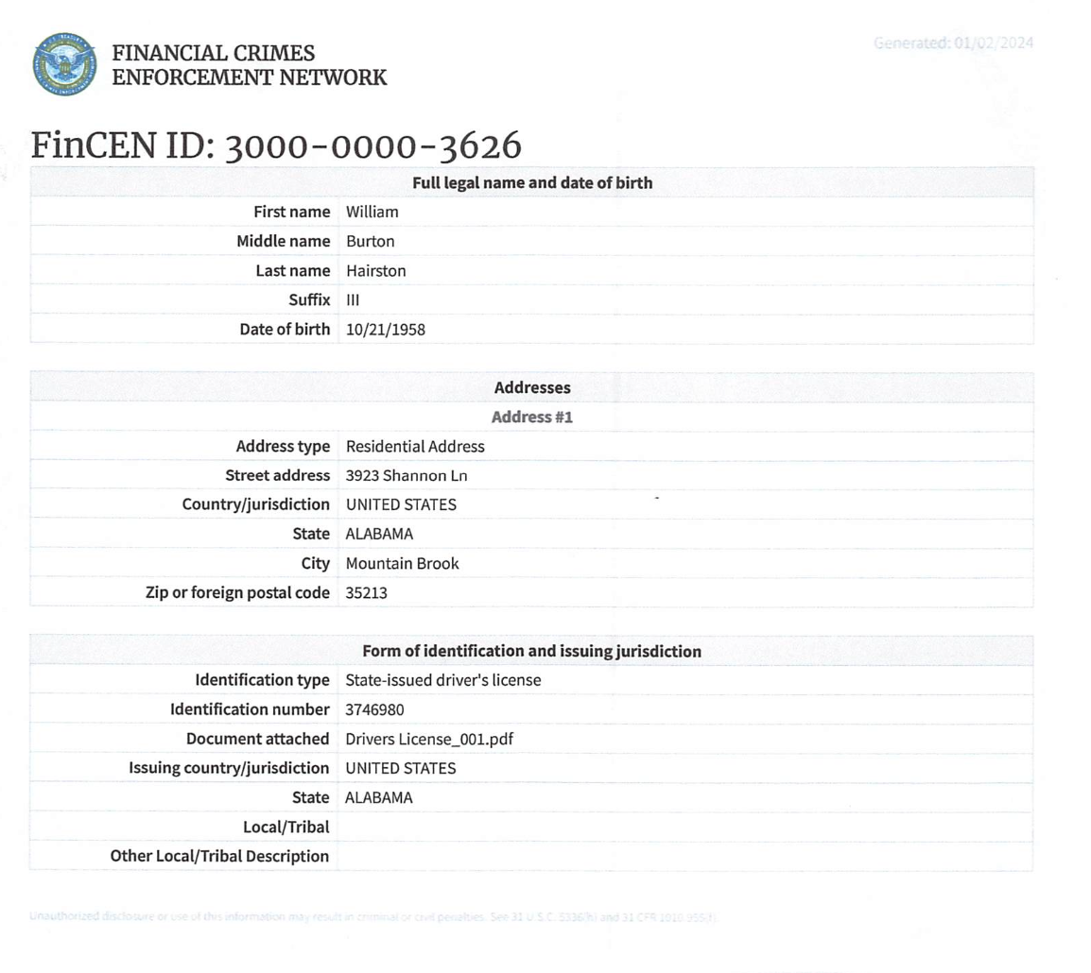
FinCEN ID Results
Hairston-22
Notes:
Name, number and identifying device

Slide 23
Penalties
Hairston-23
All Senior Officers responsible
Individual responsible if individual fails to supply company with necessary information or inaccurate information
$500/day up to $10,000 penalty for willful failure to report, correct, or update
Up to two (2) years imprisonment
Notes:
Every “senior officer” and others who cause the failure will be subject to civil and criminal penalties for late disclosure, nondisclosure, misdisclosure, and failures to update
Easier to prove violation than underlying crime
Marijuana and illegal drugs tax
Must racketeering cases include tax count (and now a CTA count)

Slide 24
Safeharbor
Hairston-24
Fixing inaccurate report within 90 days from the discovery of the inaccuracy

Slide 25
Duty to Notify?
Each Secretary of State is to inform its database of CTA’s requirements.
What about Attorney’s duty:
Maryland does not require attorneys to notify former clients.
Oklahoma does not require attorneys to notify former clients.
What about clients for whom the representation has never been terminated?
What about current clients?
Hairston-25

Slide 26
Drafting Suggestions?
Hairston-26
Limit confidentiality clauses
Impose express obligation that individuals obtain and maintain a FinCEN ID and provide that ID to Company
Impose express obligation upon members and managers to provide information necessary for company to submit and update beneficial ownership information.
Add the following clause:
Beneficial Ownership Reporting: Each Member agrees and covenants to provide to the Company such information, including all personal identifying information and an “acceptable identification document,” required by the Company to comply with the Corporate Transparency Act 31 U.S.C. §5336
Notes:
Regs do not discuss whether you can require individual to obtain (and keep current) FinCEN ID but that might be something to include in documents

Slide 27
Engagement Letter CTA Clause
Hairston-27
U.S. Corporate Transparency Act (“CTA”) Compliance. You may know that federal law now requires many entities to report beneficial ownership and other entity information to the federal government. Compliance with the CTA is the responsibility of the reporting entity. Our engagement does not include any such filing or reporting or legal advice relating to compliance with the CTA, absent a further express written agreement. Even if our engagement includes assistance in connection with (i) forming or registering an entity, or (ii) a transaction that may trigger a reporting obligation, we will not advise you in connection with the CTA absent an express written agreement to do so. Finally, you agree that we will not monitor changes in the law or in your business that may require updating your CTA reports, and that we will not suggest any such changes.

Slide 28
No Bearer Shares / LLC Interests
Hairston-28
“NO BEARER SHARE CORPORATIONS OR LIMITED LIABILITY COMPANIES.
A corporation, limited liability company, or other similar entity formed under the laws of a State or Indian Tribe may not issue a certificate in bearer form evidencing either a whole or fractional interest in the entity.”
Application to existing corporations and LLCs?
Notes:
Digital Ledger technology
Blockchain

Slide 29
Resources
Hairston-29
Corporate Transparency Act
Small Entity Compliance Guide
31 U.S.C. 5336 (Beneficial ownership information reporting requirements)
87 FR 59498 (9/30/22)
31 CFR 1010.380 (excerpt from Beneficial Ownership information Reporting Requirements Final Rule)
Beneficial Ownership Information Reporting Deadline Extension for Reporting Companies Created or Registered in 2024
Use of FinCEN Identifiers for Reporting Beneficial Ownership Information of Entities
Beneficial Ownership Information Reporting Requirements Final Rule and Fact Sheet
Beneficial Ownership Information Access and Safeguards Final Rule and Fact Sheet
Introduction to Beneficial Ownership Information Reporting
Or if all else fails, simply CONTACT FinCEN

Slide 30
Questions and Answers
Hairston-30
Bill Hairston
Hairston@me.com
205-919-1008

